Slide 1
National Day of Remembrance of the Québec City Mosque Attack and Action against Islamophobia THE GREEN SQUARE CAMPAIGN Material for Educators

Slide 2
Beginning in a Good Way
We recognize that the NCCM’s work takes place on the traditional territories and ancestral lands of Indigenous peoples occupied by Canada. We acknowledge that we are on the traditional territory of the Wendat, the Haudenosaunee, and the Anishinaabe peoples, whose presence here continues to this day.
We recognize and deeply appreciate their historic connection to this place. We also recognize the contributions that Métis, Inuit, and other Indigenous peoples have made and continue to make in strengthening this community in particular, and our province and country as a whole.
Artist: Evan Wouthius Grade 9, Lakehead Public Schools.
Notes:
As we work to challenge the discrimination Canadian Muslims face, that we need to do more to support indigenous peoples, and that our work is interconnected with indigenous struggles, past and present, in many ways.
Don’t just read this but make a meaningful connection *****

Slide 4
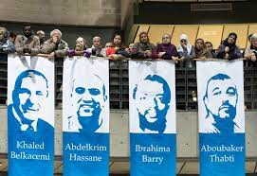
What Happened?
On January 29th, 2017, the Islamic Cultural Centre of Quebec City was subjected to a tragic, hateful and Islamophobic crime. A gunman who was radicalized with white supremacist ideology entered the place of worship and opened fire on Muslim congregants, killing six men and injuring many more.
As we approach January 29th, it is important to be mindful that this time can be increasingly difficult and re-traumatizing for Muslim staff, students and families.

Slide 5
What is the Green Square Campaign?
The Green Square Campaign takes place in the week leading up to January 29 every year to remember the victims and survivors of the Quebec City mosque attack. The green square represents the green carpets of the Quebec City mosque, where the victims last stood to pray. It symbolizes the fact that the deceased are, God willing, in a garden green, in a better place since they left us that night.
Wear the green square in solidarity with the six widows, the seventeen children left fatherless, Aymen Derbali who is left paralyzed for life, and every single person suffering the consequences of this hateful and despicable act of violence.
For more information on the Green Square Campaign (GSC) visit
NCCM Green Square Campaign - Educator Resource Webpage

Slide 6
Designated Day: January 29th "National Day of Remembrance of the Québec City Mosque Attack and Action against Islamophobia"
Since January 2020, the Federal Government has designated January 29th as the National Day of Remembrance of the Quebec City Mosque Attack and Action Against Islamophobia.
The survivors of this tragic act of terror wish for all to be involved in creating a safer future for Canadian Muslims by remaining committed to meaningful Action against Islamophobia.
Addressing this day meaningfully in schools and classrooms is essential to creating and maintaining safer and inclusive learning spaces for Muslim staff, students and families.
We have gathered resources including lesson plans, educator resources and mental health supports that will equip educators to meaningfully remember this designated day.

Slide 7
Checklist to Commemorate Designated Day
Steps to Meaningfully Remember the National Day of Remembrance of the Québec City Mosque Attack and Action against Islamophobia
Announcement – Check out the pre-written announcement in the Educator Handbook
Hand out Green Squares – Refer to the first class-activity for directions on creating your own green square OR request some squares from NCCM
Send out a school-wide memo – Use the pre-written announcement in the Educator Handbook as the memo to educate all staff on this national designated day
Use lesson plans from the Materials for Educator Handbook – This Handbook contains several Primary – Secondary level lesson plans and resources

Slide 8
Resources for Educators
Check out our resource guide for lesson plan activities, discussion prompts and even school announcements that are rooted in trauma-informed, anti-racist, and anti-Islamophobic frameworks. Green Square Campaign Resource Guide for Educators
Book an NCCM Workshop to learn how to promote equity and inclusion, and empower Canadian Muslim students, colleagues and families. Click here to request a workshop and view our Workshop Menu Request a Workshop
For more information on the Green Square Campaign, please visit our NCCM Green Square Campaign Webpage
Sign up for our Educators Newsletter Here to receive multiple annual newsletters centering anti-racist, anti-Islamophobia and equity-based classroom resources

Slide 9
Healing Centered Approaches
As we approach January 29th, it is important for us to be mindful that this time can be increasingly difficult for Muslim staff, students and families. Creating a safe space becomes necessary for students to feel supported while engaging with anti-Islamophobia content that centers this action of terror. Below are resources that can help support student:
Counter Islamophobia Lesson and Webpage; Learning for Justice Webpage
The Challenge Islamophobia Project (webpage with free lesson plans rooted in trauma informed approaches); Challenge Islamophobia Project
META K-12 Educator Resources – Remembering January 29th https://drive.google.com/file/d/1B7GtuspwvqpnLTFVf-tIb5GIBNunLvKq/view
Guides for Using Trauma Informed Discussion Techniques; Trauma Informed Discussion Guides
Article on Trauma-Informed Education; Understanding Trauma-Informed Education

Slide 10
Centering Wellness - Resources
Counter Islamophobia Webpage Learning for Justice | Culturally Responsive Mental Health Supports (Below) | Connect with NCCM to Report an Incident | Request a Workshop
The Challenge Islamophobia Project (lesson plans) Challenge Islamophobia Project | Sign up for our Educators Newsletter Here | Guides for Using Trauma Informed Discussion Techniques; Trauma Informed Discussion Guides | Green Square Campaign Educator Resources

Slide 11
Culturally Responsive Mental Health Supports
A strong trauma-informed approach is to offer Muslim students, colleagues and families mental health supports leading up to January 29th and beyond.
Khalil Center : is a psychological and spiritual community wellness center advancing the professional practice of psychology rooted in Islamic principles
Cedarway Therapy : trained and experienced clinicians from diverse backgrounds, speaking different languages (English, French, Arabic, Urdu, Gujarati, Hindi, Punjabi), and offering culturally and spiritually responsive services
Affective - Consulting and Psychotherapy : Low cost, private psychotherapy service geared towards supporting Muslim youth
Naseeha : provides an anonymous, non-judgmental, confidential and toll-free peer support helpline for youth experiencing personal challenges. Naseeha’s services are open to all regardless of age, race, ethnicity, sexual orientation, gender identity, family makeup, social status, income, ability, physical and mental health, and religion. Phone: 1 (866) 627-3342, Text: 1 (866) 627-3342

Slide 12
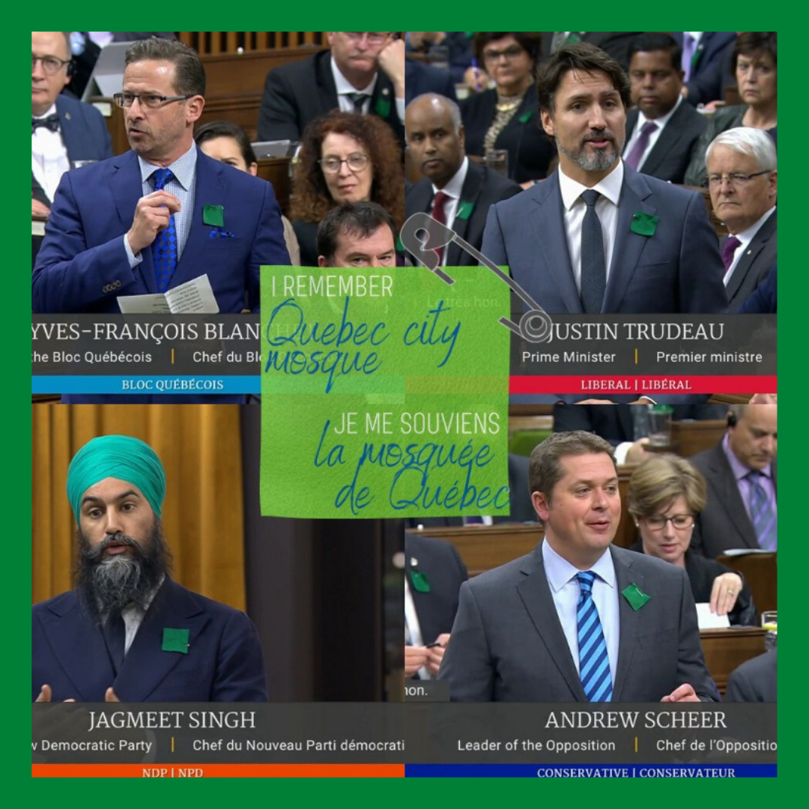
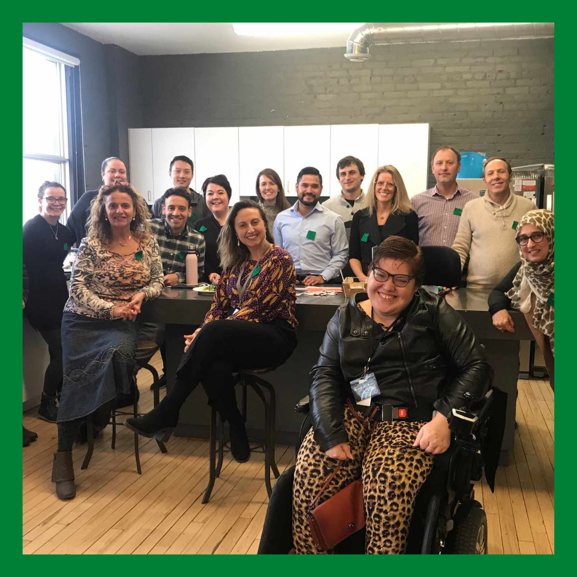
Community Support Gallery

Slide 13
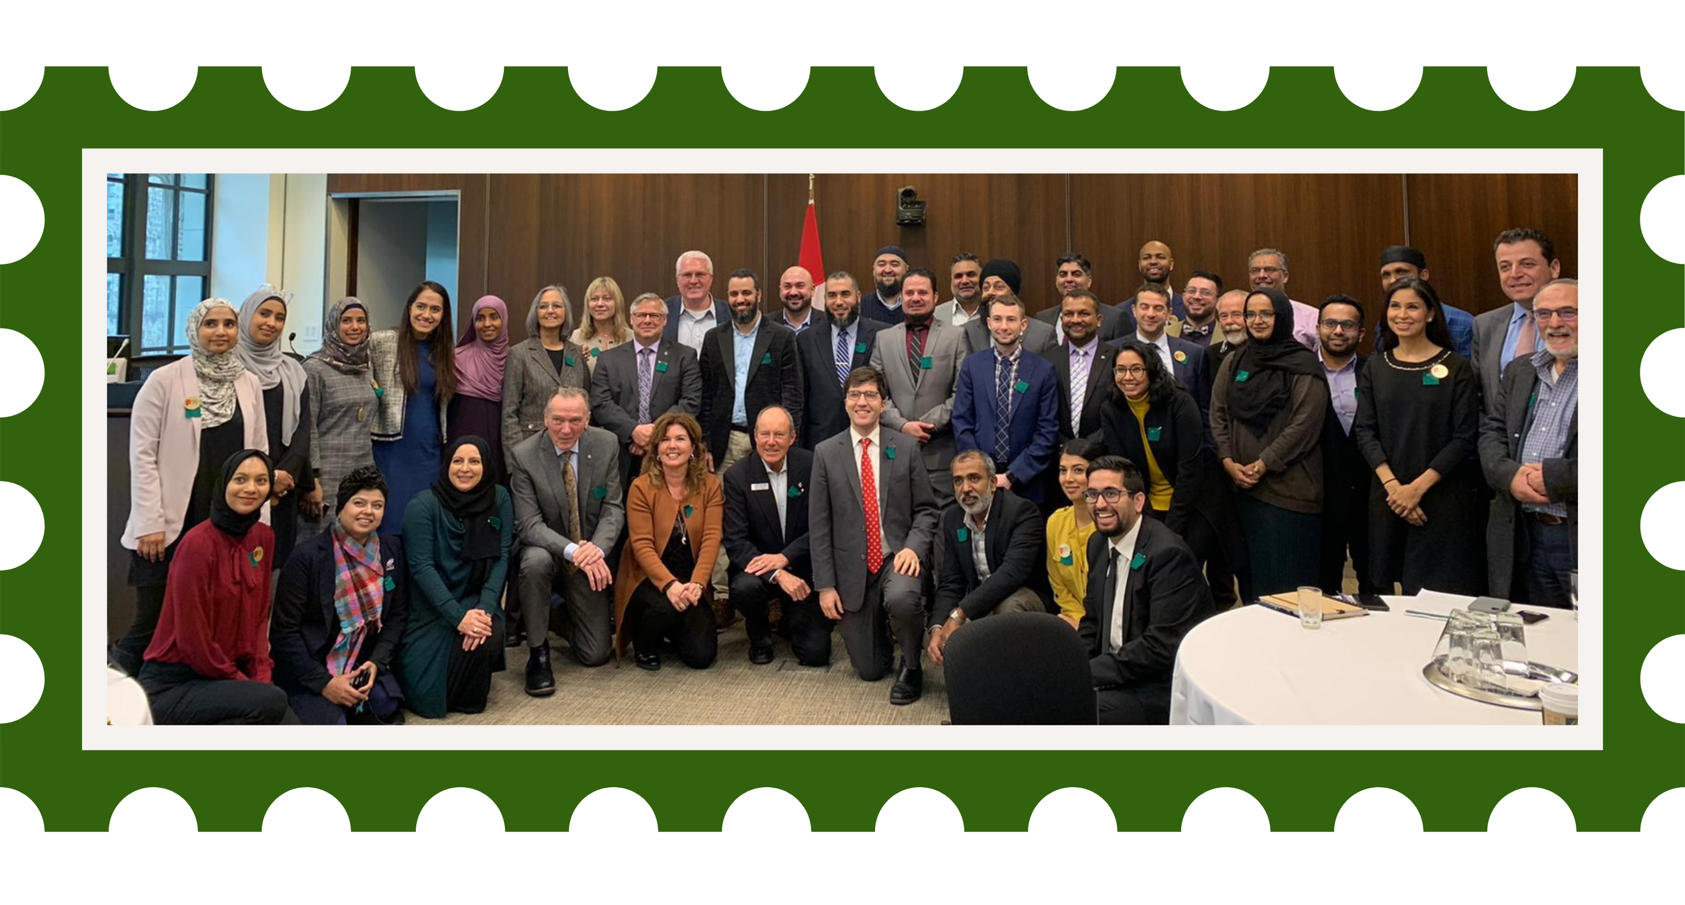
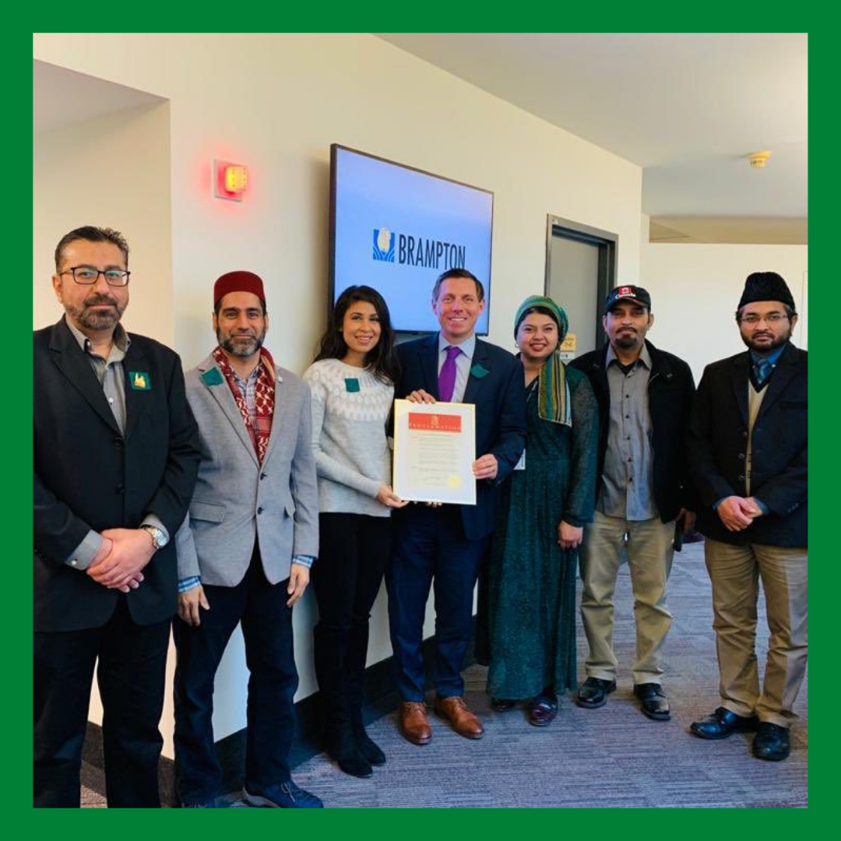
Community Support Gallery

Slide 14
Thank you!
Contact NCCM’s Education Department with any questions!
Manager of Education Programs
Jannat Firdous.
Email: jannat@nccm.ca
@nccmeducate @nccmeducate
facebook.com/NCCM

